Slide 1
Multiple Linear Regression

Slide 2
Outline
Example of MLR
Multiple Linear Regression

Slide 3
Example of GDEX, FDEX
Let’s assume that you are a small business owner for Regional Delivery Service (GDEX) who offers same-day delivery for letter, packages and other small cargo. You are able to use Google Maps to group individual deliveries into one trip to reduce time and fuel costs. Therefore some trips will have more than one delivery.
As the owner, you would like to be able to estimate how long a delivery will take based on two factors
The total distance of the trip in miles and
The number of deliveries that must be made during the trip

Slide 4
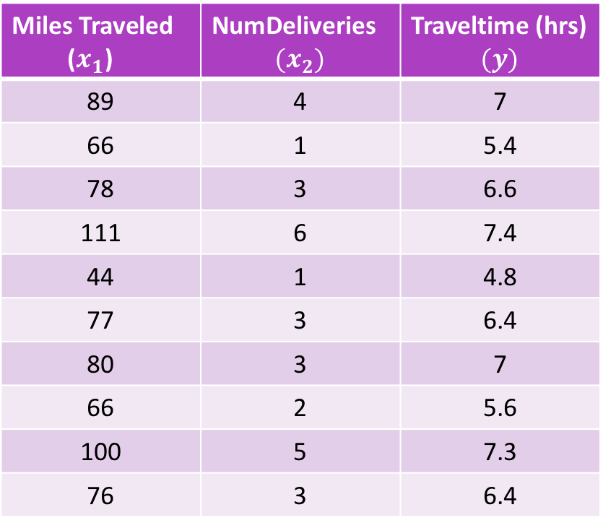
Data and variable naming
Miles Traveled ($x_{1}$) | NumDeliveries $$(x_{2})$$ | Traveltime (hrs) $$(y)$$
89 | 4 | 7
66 | 1 | 5.4
78 | 3 | 6.6
111 | 6 | 7.4
44 | 1 | 4.8
77 | 3 | 6.4
80 | 3 | 7
66 | 2 | 5.6
100 | 5 | 7.3
76 | 3 | 6.4
To conduct the analysis we take a random sample of 10 past trips and record three pieces of information for each trip
Total miles traveled
Number of deliveries
Total travel time in hours

Slide 5
DependeNt and Independent variables
In this case, we would like to predict the total travel time using both the miles traveled and number of deliveries on each trip
In what way does the travel time DEPEND on the first two measures?
Travel time is the dependent variable and miles traveled and number of deliveries are independent variables.
Dependent variable = Predictor variable
Independent variable = Response variable

Slide 6
Multiple Regression
Multiple regression is an extension of simple linear regression

Slide 7
Simple Linear Regression one to one
Independent Variable
Dependent Variable

Slide 8
Multiple Regression many to one
Dependent Variable
Independent Variable
Independent Variable
Independent Variable

Slide 9
Overfitting and multicollinearity
Adding more independent variables to a multiple regression procedures does not mean the regression will be better or offer better predictions; in fact it can make things worse. This is called overfitting.
The addition of more independent variables create more relationships among them. The independent variables related to the dependent variable. The independent variables potentially related to each other. When this happens, it is called multicollinearity
The ideal is for all of the independent variables to be correlated with the dependent variable but not with each other

Slide 10
Preparation
Due to overfitting and multicollinearity, there is a step called preparation need to be done before conducting the multiple regression
Correlations
Scatter plots
Simple regressions

Slide 11
multicollinearity
Travel time
(y)
NumDeliveries ${(x}_{2})$
NumDeliveries 〖(𝑥〗_2)
Miles Travelled
($x_{1}$)
Miles Travelled
(𝑥_1)
Dependent Variable
Independent Variable
Potential Multicollinearity

Slide 12
multicollinearity
Dependent Variable
Independent Variable 1
Independent Variable 2
Independent Variable 3

Slide 13
Multiple Regression Model
The equation that describes how the dependent variable y is related to the independent variables x₁, x₂, . . . x_{p} and an error term is:
Multiple Regression Model
y = β₀ + β₁x₁ + β₂x₂ + . . . + β_{p}x_{p} + ε
where:
β₀, β₁, β₂, . . . , β_{p} are the parameters, and
ε is a random variable called the error term

Slide 14
Multiple Regression Equation
Multiple Regression Equation
The equation that describes how the mean value of y is related to x₁, x₂, . . . x_{p} is:
E(y) = β₀ + β₁x₁ + β₂x₂ + . . . + β_{p}x_{p}

Slide 15
Estimated Multiple Regression Equation
Estimated Multiple Regression Equation
^
y = b₀ + b₁x₁ + b₂x₂ + . . . + b_{p}x_{p}
A simple random sample is used to compute sample statistics b₀, b₁, b₂, . . . , b_{p} that are used as the point estimators of the parameters β₀, β₁, β₂, . . . , β_{p}.

Slide 16
Estimation Process
Multiple Regression Model
E(y) = β₀ + β₁x₁ + β₂x₂ +. . .+ β_{p}x_{p} + ε
Multiple Regression Equation
E(y) = β₀ + β₁x₁ + β₂x₂ +. . .+ β_{p}x_{p}
Unknown parameters are
β₀, β₁, β₂, . . . , β_{p}
Sample Data:
x₁ x₂ . . . x_{p} y
. . . .
. . . .
Estimated Multiple
Regression Equation
Sample statistics are
b₀, b₁, b₂, . . . , b_{p}
b₀, b₁, b₂, . . . , b_{p}
provide estimates of
β₀, β₁, β₂, . . . , β_{p}

Slide 17
Least Squares Method
Least Squares Criterion
Computation of Coefficient Values
The formulas for the regression coefficients
b₀, b₁, b₂, . . . b_{p} involve the use of matrix algebra.
We will rely on computer software packages to
perform the calculations.

Slide 18

Estimated multiple regression equation
$$\hat{y}=6.0+0.4x_{1}+0.3x_{2}−0.6x_{3}$$
$$\hat{y}=\hat{β_{0}}+\hat{β_{1}}x_{1}+β_{2}x_{2}−β_{3}x_{3}$$

Slide 19
EXAMPLE
A health researcher wants to be able to predict "VO₂max", an indicator of fitness and health. A researcher recruited 100 participants to perform a maximum VO₂max test, but also recorded their "age", "weight", "heart rate" and "gender". Heart rate is the average of the last 5 minutes of a 20 minute, much easier, lower workload cycling test. The researcher's goal is to be able to predict VO₂max based on these four attributes: age, weight, heart rate and gender.

Slide 20

OUTPUT
1. Determining how well the model fits
The "R" column represents the value of R, the multiple correlation coefficient. R can be considered to be one measure of the quality of the prediction of the dependent variable; in this case, VO₂max.
A value of 0.760, in this example, indicates a good level of prediction.
The "R Square" column represents the R² value (also called the coefficient of determination), which is the proportion of variance in the dependent variable that can be explained by the independent variables (technically, it is the proportion of variation accounted for by the regression model above and beyond the mean model).
You can see from our value of 0.577 that our independent variables explain 57.7% of the variability of our dependent variable, VO₂max. However, you also need to be able to interpret "Adjusted R Square" (adj. R²) to accurately report your data. We explain the reasons for this, as well as the output, in our enhanced multiple regression guide.

Slide 21
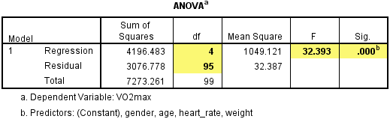
2. Statistical significance
The F-ratio in the ANOVA table (see below) tests whether the overall regression model is a good fit for the data. The table shows that the independent variables statistically significantly predict the dependent variable, F(4, 95) = 32.393, p < .0005 (i.e., the regression model is a good fit of the data).

Slide 22
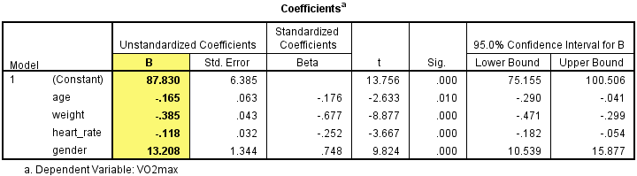
3. Estimated model coefficients
The general form of the equation to predict VO₂max from age, weight, heart_rate, gender, is:
Predicted VO₂max = 87.83 – (0.165 x age) – (0.385 x weight) – (0.118 x heart_rate) + (13.208 x gender)
Unstandardized coefficients indicate how much the dependent variable varies with an independent variable when all other independent variables are held constant. Consider the effect of age in this example. The unstandardized coefficient, B₁, for age is equal to -0.165 (see Coefficients table). This means that for each one year increase in age, there is a decrease in VO₂max of 0.165 ml/min/kg.

Slide 23
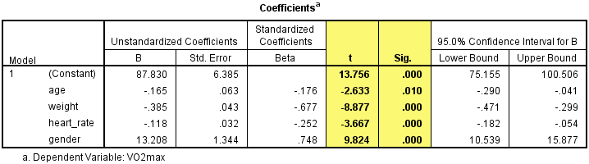
4. Statistical significance of the independent variables
You can test for the statistical significance of each of the independent variables. This tests whether the unstandardized (or standardized) coefficients are equal to 0 (zero) in the population. If p < .05, you can conclude that the coefficients are statistically significantly different to 0 (zero). The t-value and corresponding p-value are located in the "t" and "Sig." columns, respectively, as highlighted below:
You can see from the "Sig." column that all independent variable coefficients are statistically significantly different from 0 (zero). Although the intercept, B₀, is tested for statistical significance, this is rarely an important or interesting finding.

Slide 24
5. Conclusion
A multiple regression was run to predict VO₂max from gender, age, weight and heart rate. These variables statistically significantly predicted VO₂max, F(4, 95) = 32.393, p < .0005, R² = .577. All four variables added statistically significantly to the prediction, p < .05.

Slide 25
THANK YOU!

